Slide 1
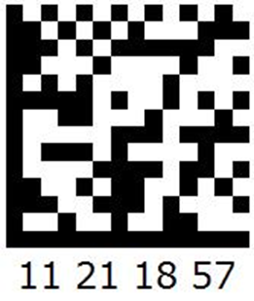
Codes
Codes are a list of QR or Barcodes that can be generated by the Dashboard
These codes can be used to create email, SMS, Web etc campaigns
These codes can be distributed to vendors to allow your users to have special privileges or product in other stores
Or they can be used to control access of users to a member group to limit access to certain products (e.g. cigarettes)

Slide 2
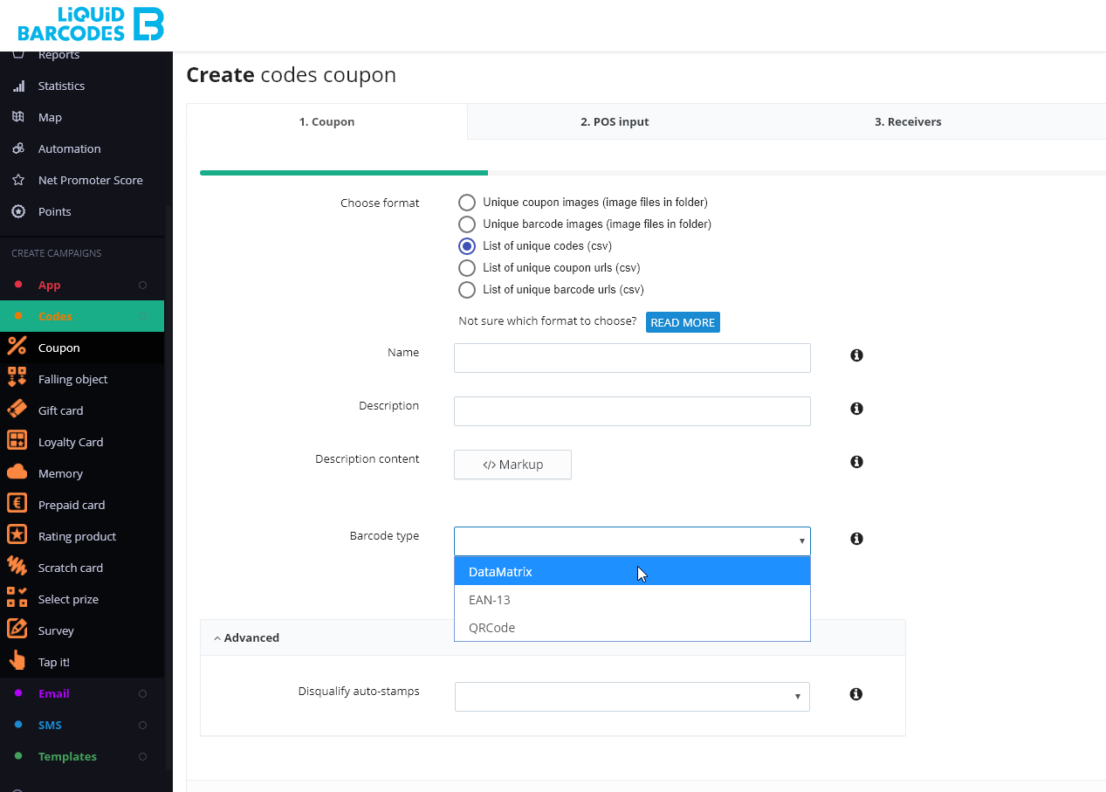
Coupon codes
The simplest usage is to create codes for a campaign. E.g. Lucky Draw
Choose format
Codes for own distribution are available in the following formats (examples with DataMatrix barcode type):
Unique coupon images (image files in folder)
Unique barcode images (image files in folder)
List of unique codes (csv)
List of unique coupon urls (csv)
List of unique barcode urls (csv)
CODES
Pressing codes int the APP menu will open up the Codes coupon screen

Slide 3
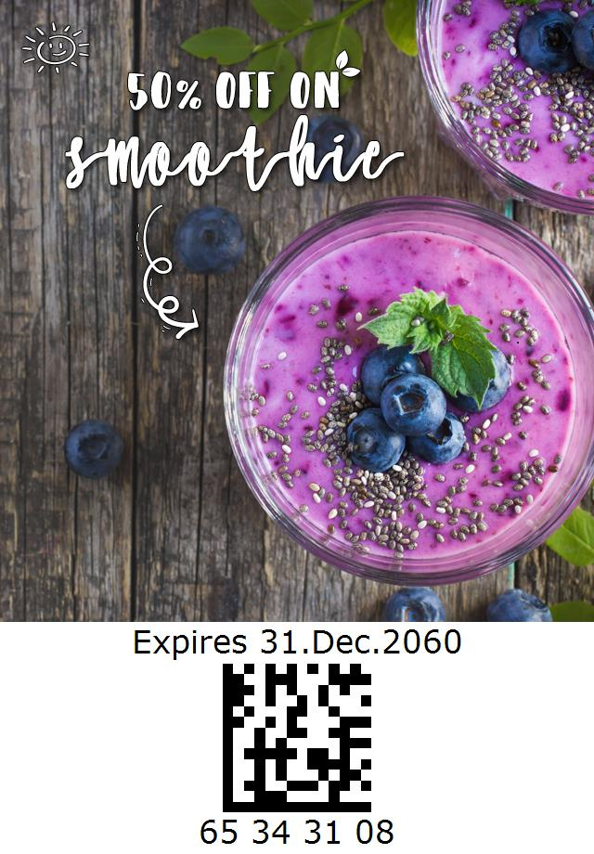
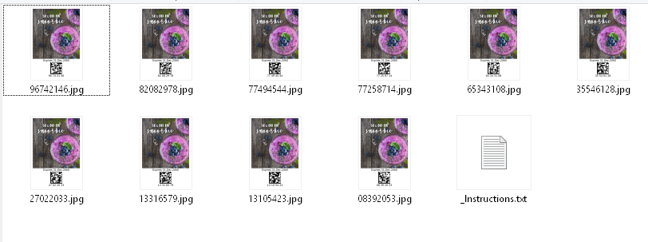
Codes format
Note: if you order more than 100.000 coupons, we recommend avoiding this format due to large file size.

Slide 4
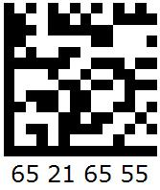
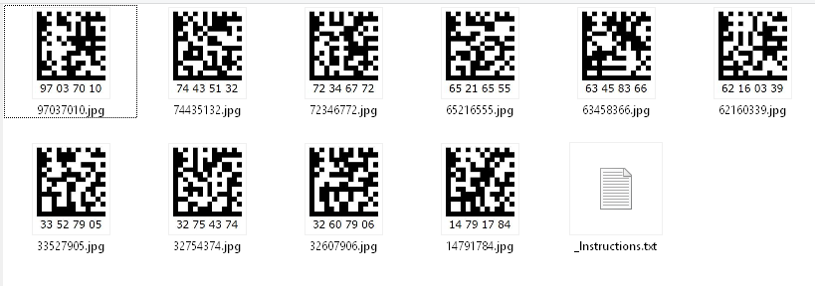
Codes format
Note: if you order more than 100.000 coupons, we recommend avoiding this format due to large file size.
A wide range of barcode types is supported. The most commonly used are DataMatrix and EAN13.
4

Slide 5
Codes format
Note: We can support a wide range of barcode types. The most commonly used are DataMatrix and EAN13.

Slide 6
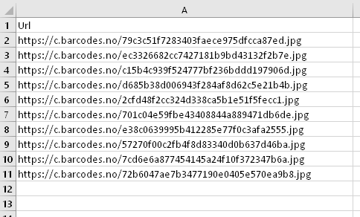
Codes format
6

Slide 7
User groups- Create codes to access the group
Note: if you order more than 100.000 coupons, we recommend avoiding this format due to large file size.

Slide 8
User groups- Create codes to access the group
Note: if you order more than 100.000 coupons, we recommend avoiding this format due to large file size.

Slide 9
User groups- Create codes to access the group
Note: if you order more than 100.000 coupons, we recommend avoiding this format due to large file size.

